Slide 1
Novel Multicast Protocol Proposal Introduction
25 October 2021
Authors: Jiangsheng, Xu Bing, Yan Shen, Meng Rui, Wan Junjie, Wang Chuang
[jiangsheng|bing.xu|yanshen|mengrui|wanjunjie2|wangchuang]@huawei.com

Slide 2
Trends & challenges of multicast
Introduction and virtue of Carrier-Grade Minimalist Multicast
Examples of application scenarios

Slide 3

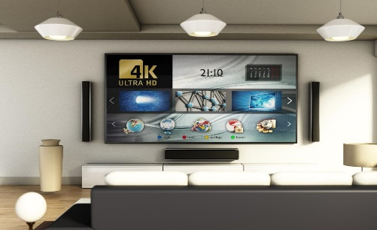






Industry upgrade brings new scenarios for multicast
4K/8K UHD Video
By 2023, more than 600 million households will have UHD TVs. Traditional SDI equipment can no longer meet the demand for large-scale UHD video production and transmission, and Media Broadcast Network has been distributing resources through multicast technology.
Financial Quotes & Trading
It is a common practice in the industry to use multicast technology for pushing securities quotes; Multicast technology is also used in the distributed trading systems of leading international financial exchanges (Nasdaq, Deutsche).
Autonomous driving & V2X scenarios
The evolutionary version of 5G, R16 introduces multicast technology to provide dependable technology for V2X scenarios: cooperative driving, autonomous driving assistance, vehicle fleeting, etc.
Industrial/Semiconductor Production Field
Most international semiconductor manufacturers, including Intel, use the Tibco bus platform, and communication between their device automation system EAP and other systems uses broadcast and multicast to achieve a one-to-many release subscription.

Slide 4


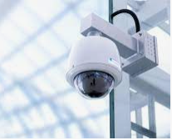







The adoption of traditional multicast technology has been lower than expected
Video conferencing & Tele-education
Financial Quotes & Trading
Video Surveillance & Emergency Rescue
Media Broadcast Network & Live Video
WeLink
DingTalk
Lark
Tencent Class
Hundreds of millions of people work and study online after the Chinese New Year in 2020, mostly based on video conferencing systems, with video lag and delay problems prevailing during peak hours.
Financial exchanges push market information to major brokerages and platforms through multicast technology. Poor recovery performance of multicast service failure has been repeatedly criticized by customers.
Video surveillance is widely used in public security and city video networks. The forwarding and replication of video streams depend on streaming servers, which leads to difficult sharing and high expansion cost.
Driven by 4K & 8K UHD video programs, the media network has fully entered the IP era, but due to the lack of cross-domain IP multicast solutions, video media distribution mainly depends on application layer multicast.
The demand for multicast services is widespread, but traditional multicast has two major technical problems: difficult deployment and complex maintance
Implement application layer-based multicast replication between server nodes
Complex server and terminal implementation, high rental costs
Application layer processing latency is too large to be applied in instant messaging scenarios
Last layer nodes are highly placed, resulting in lots of redundant traffic in the network
New Multicast？
Hop-by-hop on-demand replication based on multicast address and multicast tree state
Nodes need to maintain multicast state on a flow-by-flow basis, poor scalability
Poor deployability, all devices in the network must support multicast function, there are engineering technical difficulties
No reliability protection scheme, resulting in slow recovery of multicast services and poor convergence performance after network failure
CDN
BIER
Stateless multicast, based on bit-string for replication
No end-to-end solution, typically used in core backbone networks
The forwarding path of multicast traffic depends on IGP convergence, and the path is uncontrollable and invisible
Lack of cross-domain multicast deployment solutions
Large network sparse scenarios easily degrade to unicast

Slide 5

Carrier-Grade Minimalist Multicast Proposal Introduction
Multicast Controller
Source
Recipient
Client2
Client1
E
Recipient
A
B
D
F
Client3
C
New Multicast Router
Traditional Router
H
Recipient
Forward multicast traffic
Control signaling traffic
Encapsulation format ：
G
Client4
Unicast head
New Multicast Head
Payload
Path plannable, stateless forwarding
Flexible deployment, easy expansion
Efficient operation, reliable guarantee
The controller encapsulates the full tree in the first node packet.
The router instructs forwarding based on the Bitmap of the packet.
Forwarding is separated from the control plane. Intermediate node is stateless.
Flexible deploy on underlay or overlay network based on the scenario.
Support flower Arrangement deployment, no need upgrade in whole network.
Easy expansion, can recursively encode multicast trees of arbitrary size.
Centralized visual operation and maintenance on the control plane.
Maintenance-free on full-path devices.
Build a point-to-multipoint transmission channel to ensure service distribution; Achieve delay jitter control and fast fault convergence

Slide 6
Summary Draft of New Multicast Technical Features
Multicast services are jointly initiated and managed by users and controllers.
The controller detects the network status, plans replication nodes and transfer paths for multicast service flows, calculates hop-by-hop replication instructions, packs them, and delivers them to the multicast source or first-hop multicast router.
The multicast source or the first-hop multicast router encapsulates the replication instruction in the service data packet.
The multicast router replicates and forwards packets based on the replication instruction carried in the packets, and does not retain the state of the multicast service flows
Multicast routers precalculate protection paths and provide millisecond-level protection switching.

Slide 7
Encode Example:
Client1
C
Index | Next hop
0 | client1
1 | R
Recursive unit₀
Client2
1
Total_len:26
B:01
R:011
Len=10
S:011
C:001
D:0001
E:001
Padding(6bit)
S
0
1
1
Recursive Unit B
B
R
D
Bitmap(B)
Forwarding table(B)
Encapsulation to B
Client1
Client3
E
Index | Next hop
0 | B
1 | S
2 | E
Recursive unit₀
Recursive unit₁
Client4
1
Multicast route identifier：
Define the local bitmap。
Each bit corresponds to a multicast object, which denote the direct delivery destination of multicast packet.
Forwarding table：
Each table entry corresponds to a bit in the bitmap.
Instruct the forwarding method to the corresponding multicast object (outgoing interface, next hop address, etc.)
0
1
1
Total_len:24
R:011
Len=10
S:011
C:001
D:0001
E:001
1
1
Recursive Unit R
1
Encapsulation to R
Bitmap(R)
Forwarding table(R)
Index | Next hop
0 | R
1 | C
2 | D
Recursive unit₀
Recursive unit₁
1
Total_len:10
S:011
C:001
D:0001
Padding(6bit)
Total_len:3
E:001
Padding(5bit)
0
1
1
1
Encapsulation to E
1
Recursive Unit S
Bitmap(S)
Encapsulation to S
Unicast Packet
Forwarding table(S)
Index | Next hop
0 | S
1 | D
2 | client2
Client4
1
Total_len:3
C:001
Padding(5bit)
Total_len:4
D:0001
Padding(4bit)
0
0
1
1
Encapsulation to C
Encapsulation to D
Bitmap(C)
1
Unicast Packet
Unicast Packet
Forwarding table(C)
Client2
Client3

Slide 8
In Principle this mechanism can be integrated with IPv4 or IPv6 etc. The location of new header shall be decided during the standardization procedure.
Recursive encoding in packet
Multicast Packet：
Outer-header | Multicast Encapsulation | Inner-header | Payload
R
Recursive Unit
1
2
3
4
…
n
Fixed Field
Multicast Route identifier
Addressing Field
Recursive Unit 1
Recursive Unit 2
…
Recursive Unit n
Padding
Total len
rsv
L₁
…
L_{n-1}
Recursive Unit
1
2
3
4
…
m
Multicast Route identifier
Addressing Field
Recursive Unit 1
Recursive Unit 2
…
Recursive Unit m
The multicast encapsulation is composed of three components: a fixed filed, a recursive unit as well as sub units, together with padding information.
Fixed Field：
Total len： indicate the total length of the Recursive Unit, Filed length can be set flexibly to 8/16/32, with bit/byte/word. Padding is not included.
Rsv: Reserved Fields
Recursive Unit：
Multicast Route identifier：instructs a node to locally duplicate packets and forwarding.
Addressing Field：used for separating the following sub recursive unit, with one or more length fields indicating the length of each included sub recursive unit. If the child nodes are all leaves, this field is empty.
Recursive Unit：has the same structures as the unit it sits in.
Padding (Optional)：Used for byte alignment.

Slide 9




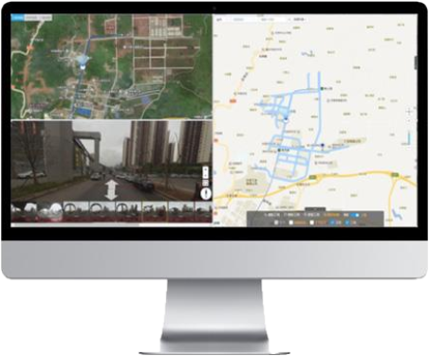

Examples of application scenarios
Video Surveillance System A
Video Surveillance System B
Multicast is already widely used in Securities Exchange Network. Core node maintained per-flow multicast states, specifications are limited;
The multicast tree is dynamically generated and the path is uncontrollable;
Slow convergence performance during link failure recovery.
Source
Recipient
Video Surveillance System does not achieve real intercommunication on the forwarding plane. The ability to share video depends on the streaming media server. Large-scale video forwarding or expansion needs to be realized by stacking servers, which is costly.
Securities Exchange Network
Multi-DC topology
…
…
Streaming media server farm
Streaming media server farm
Video Surveillance System A
Video Surveillance System B
Core node is stateless per-flow forwarding;
Multicast tree path can be planned, visualized operation and maintenance;
The network supports dual-send selective receiving and multicast FRR, and the recovery performance is improved from seconds to milliseconds.
The video Surveillance System is truly interconnected, and the video sharing capability depends only on the network's intercommunication bandwidth capability, which is in line with the trend of urban video networking
Recipient
Recipient
Speaker
Meeting
Media Unit
Meeting
Media Unit
MPLS TE based
R
The forwarding of video streams in Cloud Video Conferences needs to be forwarded through media units cascaded, causing system delays and performance bottlenecks; when the meeting peak period, the system needs to dynamically expand media server resources, meeting requests cannot be responded to in time, and the meeting experience is poor;
Area 1
Area 3
A2
N+1 Copy
E
Traditional multicast cannot provide tunneling capabilities with QoS guarantee and traffic planning; while current P2MP tunnels are generally created based on MPLS RSVP-TE, with complex protocols and cumbersome configuration.
T1
Backbone Network
A1
C
A3
R
A
B
D
R
A4
Area 2
Area 4
F
R
Meeting
Media Unit
Meeting
Media Unit
R
Speaker
Multicast FRR
A2
Area 1
Area 3
In the Cloud Video Conference SVC mode, the new multicast router is used as the access and forwarding node of the video stream. It has high performance, low delay, and saves backbone network bandwidth. No matter the peak or low period of the meeting, when the network bandwidth is satisfied, there is no need to dynamically expand resources. The experience is significantly improved.
The new multicast can provide point-to-multipoint high-reliability transmission channels more conveniently, since the multicast tree is a natural P2MP tunnel. No need to create VPN and TE tunnels, as well as new multicast has fault protection and path planning capabilities.
E
Multicast
T1
A1
C
A3
Backbone Network
R
A
B
D
R
A4
F
R
Area 2
Area 4

